Slide 1



Data Science Job Salaries Dataset - 10Alytics Data Science Project
Theresa Ofili

Slide 2
Table Of Content
Overview
Understanding the data
Data preparation
Univariate Analysis
Multivariate Analysis
Conclusion

Slide 3
OVERVIEW There are 11 columns and 607 rows in the dataset. Work year, level of experience, employment type, job title, salary, salary in US dollars, employee residence, remote ratio, company location, and company size are included in the column. For easier comprehension, the abbreviation was written in full. The headings and data were also placed consistently throughout the sheet. From the data, the company's region and home nation were also extracted. The name of the residents and the company location countries were written in full. The report consists of two different dashboards, one analyzing the number of employees within the three (3)years, and the other showing the financial aspect involved.

Slide 4


Understanding the dataset
Column | Description
work_year | The year the salary was paid.
experience_level | The experience level in the job during the year with the following possible values: EN Entry-level / Junior MI Mid-level / Intermediate SE Senior-level / Expert EX Executive-level / Director
employment_type | The type of employement for the role: PT Part-time FT Full-time CT Contract FL Freelance
job_title | The role worked in during the year.
salary | The total gross salary amount paid.
salary_currency | The currency of the salary paid as an ISO 4217 currency code.
salaryinusd | The salary in USD (FX rate divided by avg. USD rate for the respective year via fxdata.foorilla.com).
employee_residence | Employee's primary country of residence in during the work year as an ISO 3166 country code.
remote_ratio | The overall amount of work done remotely, possible values are as follows: 0 No remote work (less than 20%) 50 Partially remote 100 Fully remote (more than 80%)
company_location | The country of the employer's main office or contracting branch as an ISO 3166 country code.
company_size | The average number of people that worked for the company during the year: S less than 50 employees (small) M 50 to 250 employees (medium) L more than 250 employees (large)
Work year
Experience Level
Job Title
Salary
Employment Residence
Remote Ratio
Company Location
Company size

Slide 5

Findings and Analysis of the data When making the brave decision to change careers, salary alone cannot be the deciding factor. There are so many things to take into account. Basically, the report will examine how many people are employed in various factors and how much they have been paid based on the same parameters

Slide 6
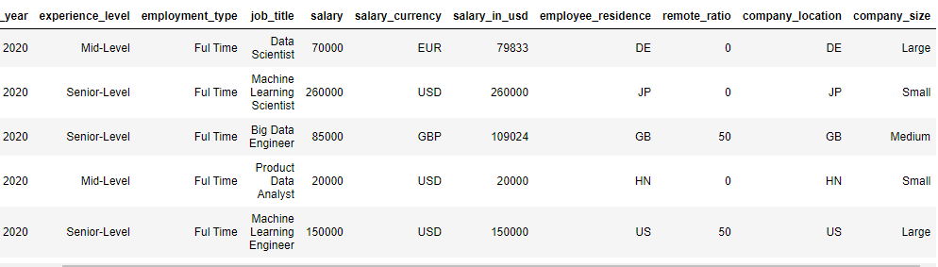
DATA PREPARATION 1. The data was cleaned by checking the missing data. 2. Renaming the necessary data for better understanding 3. Dropping the unnecessary columns 4. Checking the correlation between the data 5. Analysis of the data with the cleaned data

Slide 7
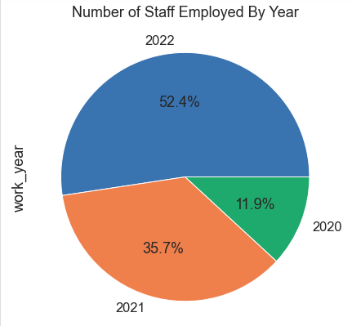
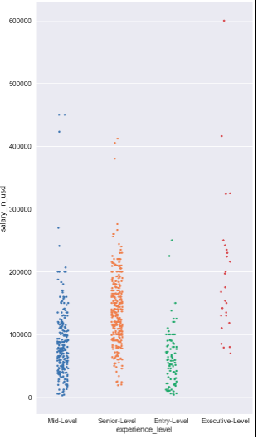
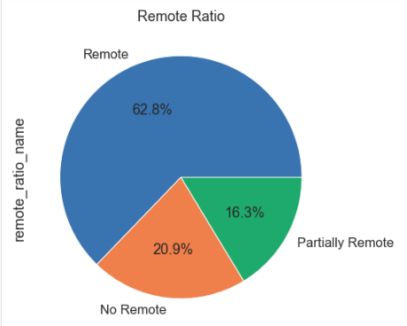
Univariate Analysis
Numeric Columns
Work Year: 2022 has the highest ratio of employed
Salary in USD: More senior and Mid levels are been paid
Remote Ratio: More remotes are employed

Slide 8
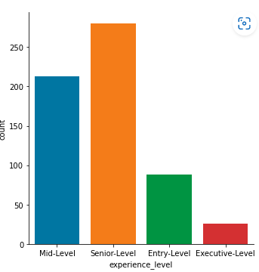
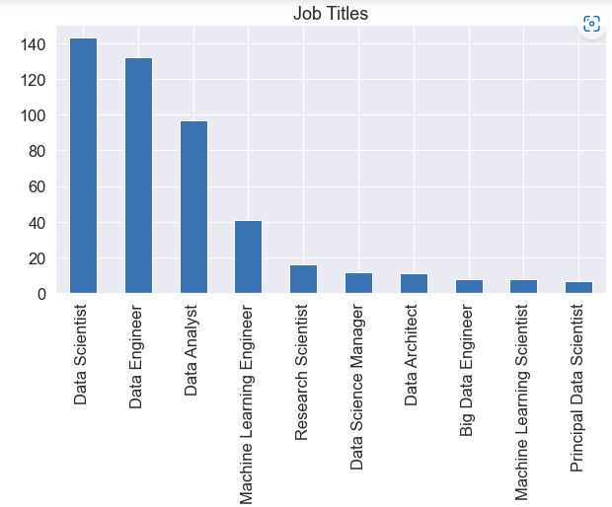
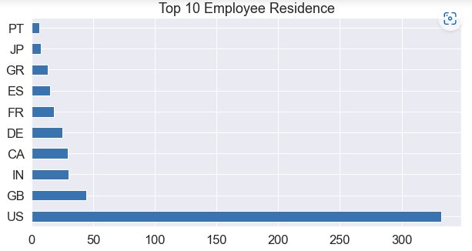
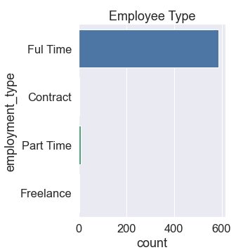
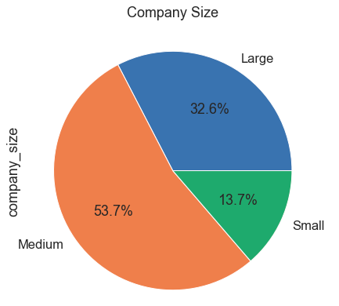
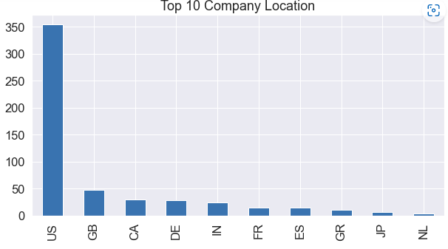
Univariate Analysis
Categorical Columns Experience Level: Senior level most employed
Job Titles: Data scientists mostly employed
Employment Type: Full Time mostly employed
Employee Residence & Company Location: the US are mostly employed in these two categories
Company Size: Medium company mostly employed

Slide 9
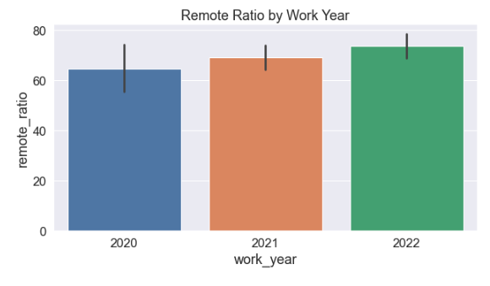
WORK YEAR REMOTE ANALYSIS
Multivariate Analysis

Slide 10
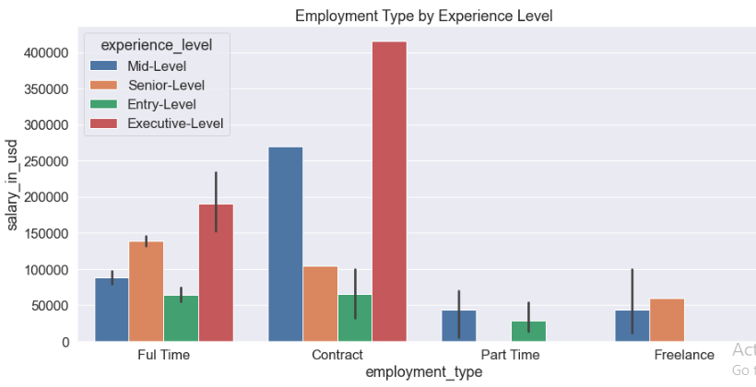
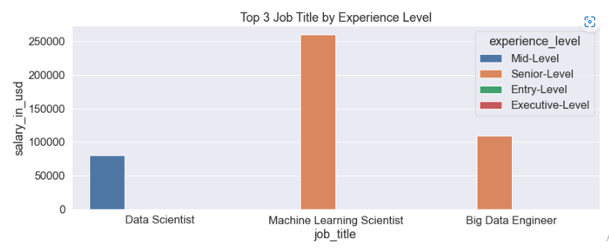
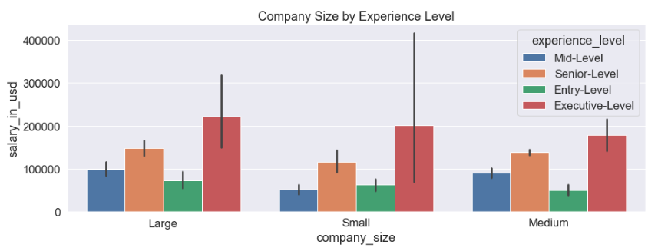
Experience Level Analysis

Slide 11

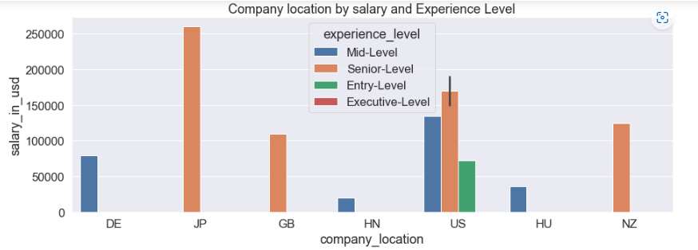
Company Location Analysis

Slide 12
Experience Level Analysis

Slide 13
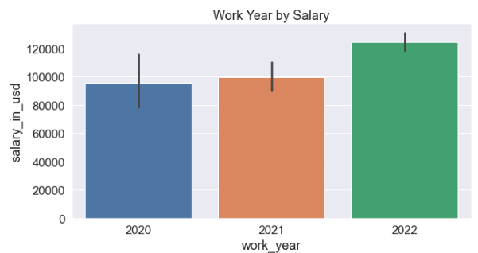
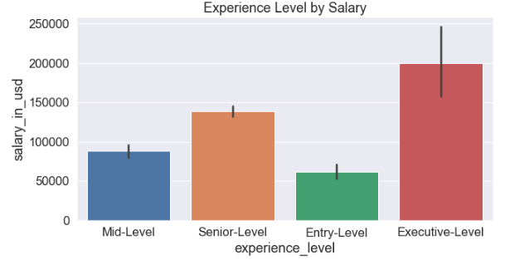
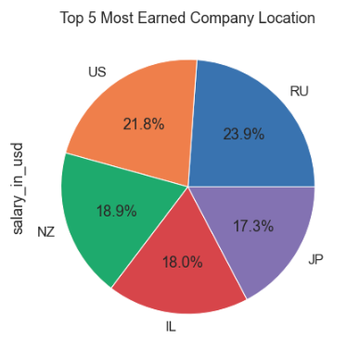
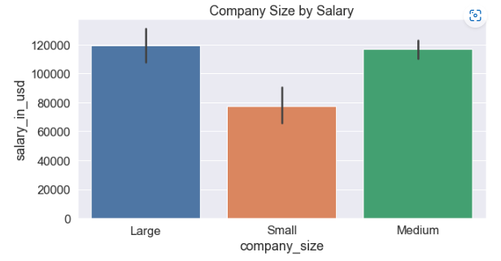
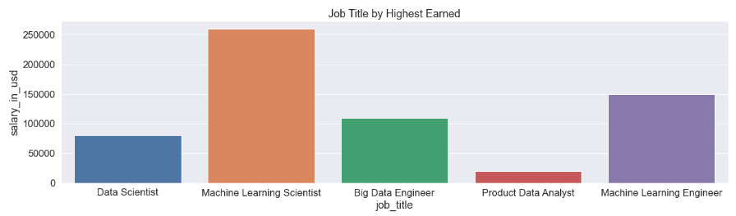
Salary Analysis

Slide 14
In conclusion, data science will keep rising and this is the best time to start the journey as a career. The exploratory analysis has clearly shown that data scientists are the most employed across the countries and they are one of the top 5 most earned.
Conclusion

